Slide 1

Plymouth
Rotary
Club

Slide 2

Plymouth Rotary
is proud to honor
it’s Veterans

Slide 3
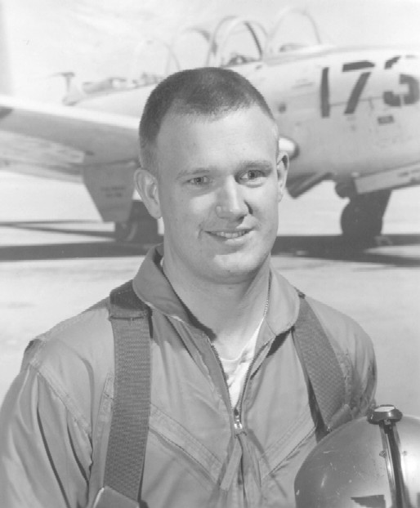
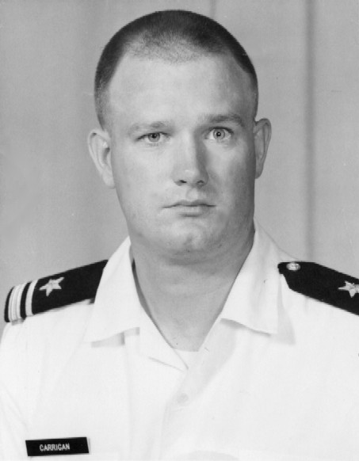
Bob Carrigan

Slide 4
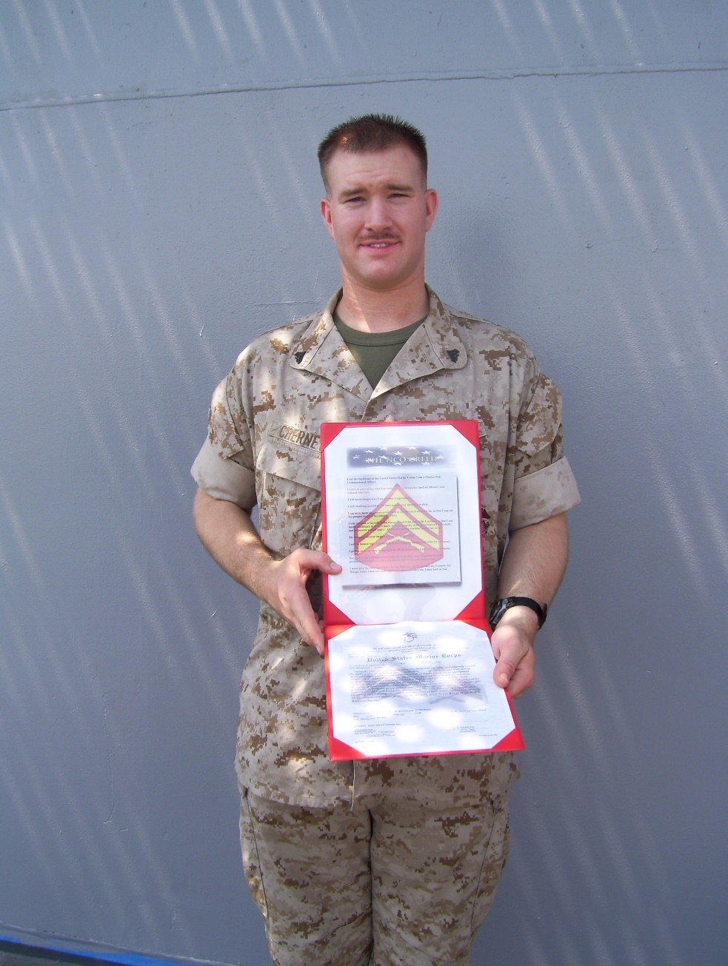
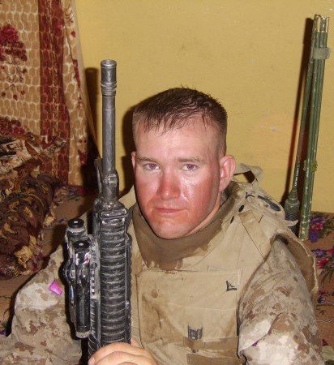
Richard Cherney

Slide 5
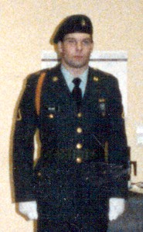
Dan DeLano

Slide 6
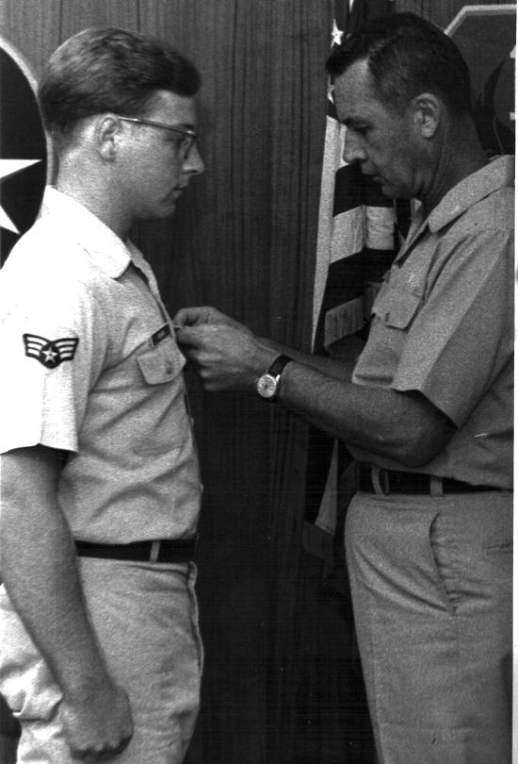
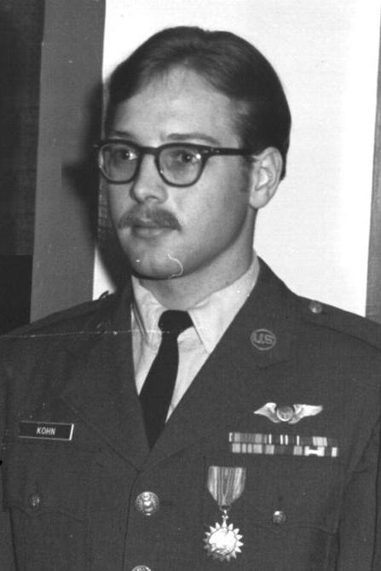
Kirk Kohn

Slide 7
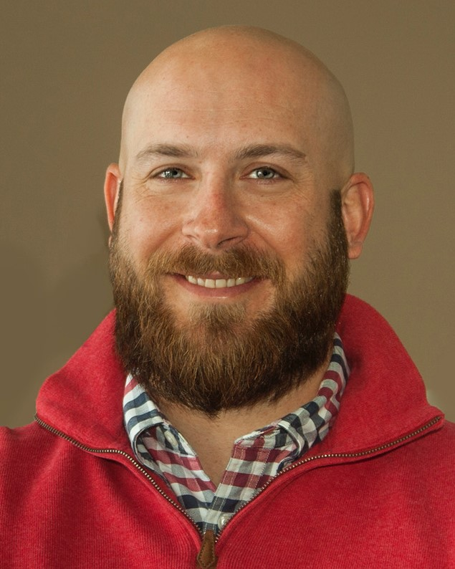
Justin Nichols

Slide 8
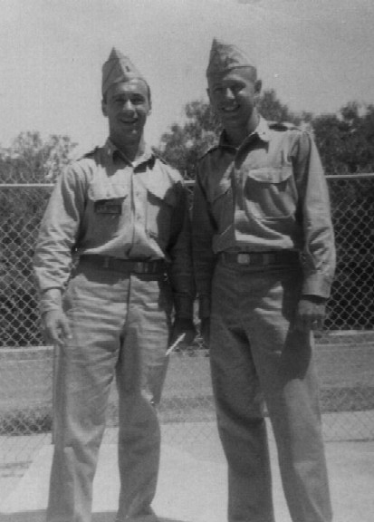
Bob Petersen

Slide 9
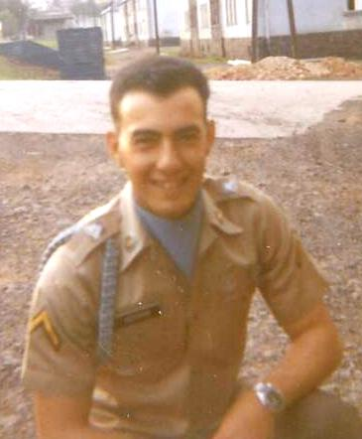
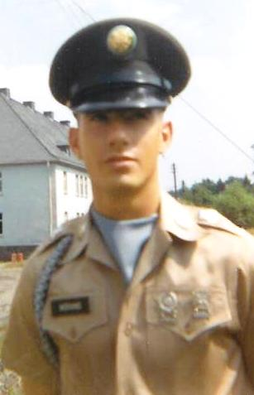
John Morano

Slide 10
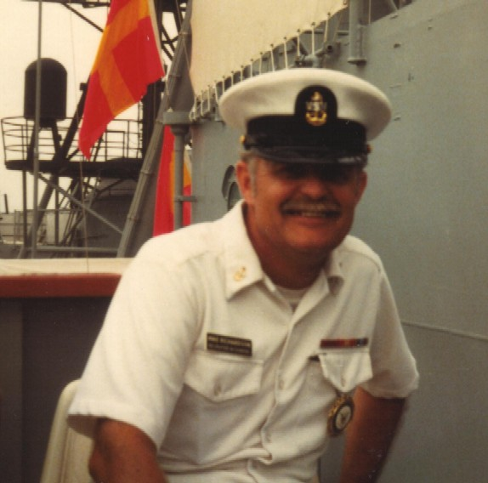
Mike Richardson

Slide 11
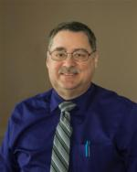
Andy Savage

Slide 12
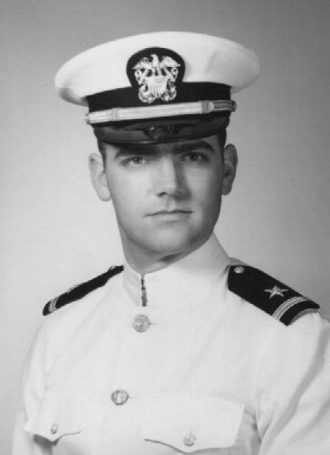
Win Schrader

Slide 13
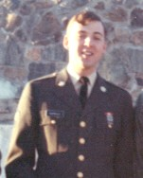
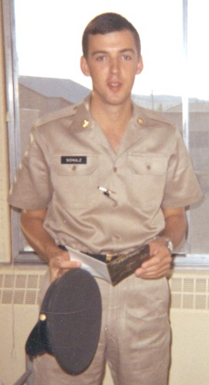
Ed Schulz

Slide 14
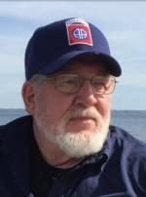
Herm Theeke

Slide 15


Slide 16

WE
REMEMBER

Slide 17
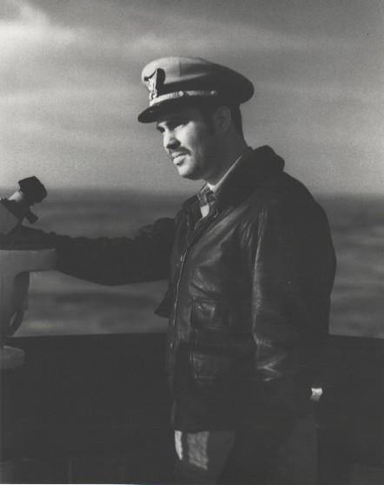
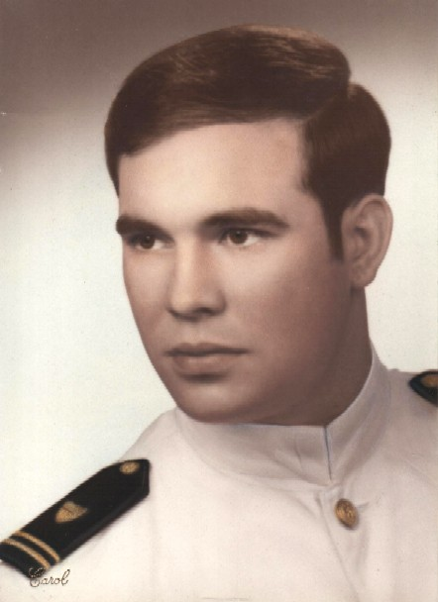
Art Butler

Slide 18
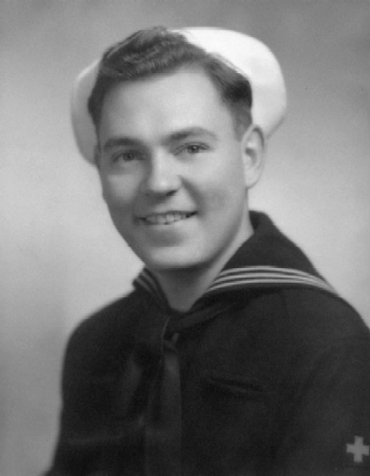
M. David
Campbell

Slide 19
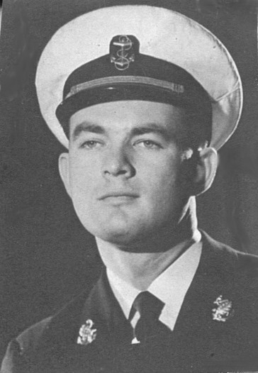
Bill
Covington

Slide 20
Clarence
DuCharme

Slide 21
Lee
Feldcamp

Slide 22
Bill
Ferman

Slide 23
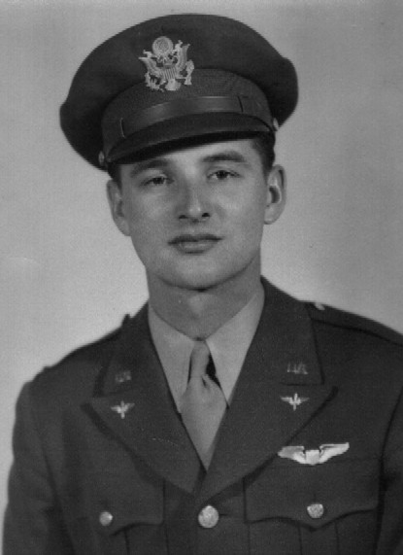
John
Gaffield

Slide 24
John
“Mike”
Hoben

Slide 25
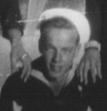
Russ
Hoisington

Slide 26
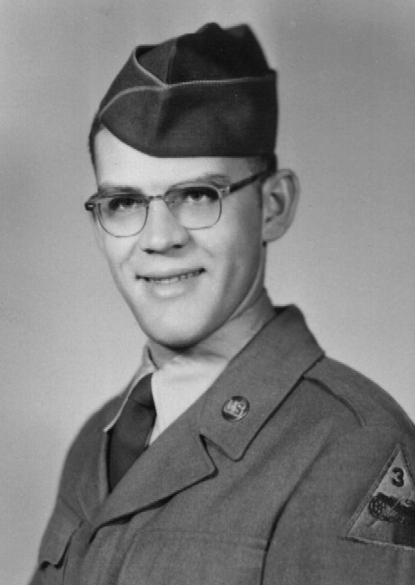
Joe
Howell

Slide 27
Ken
Hulsing

Slide 28
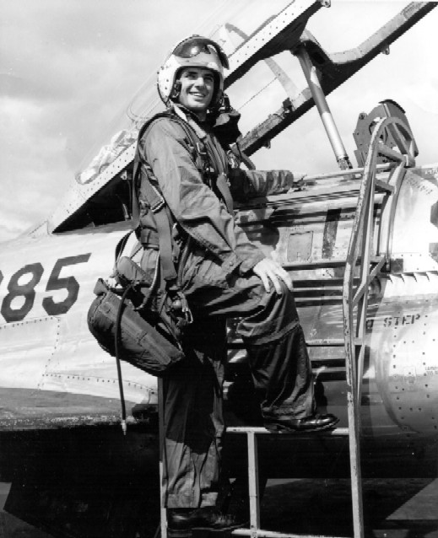
Tom Kennedy

Slide 29
Dick
Kirchgatter

Slide 30
Carl
Lampton

Slide 31
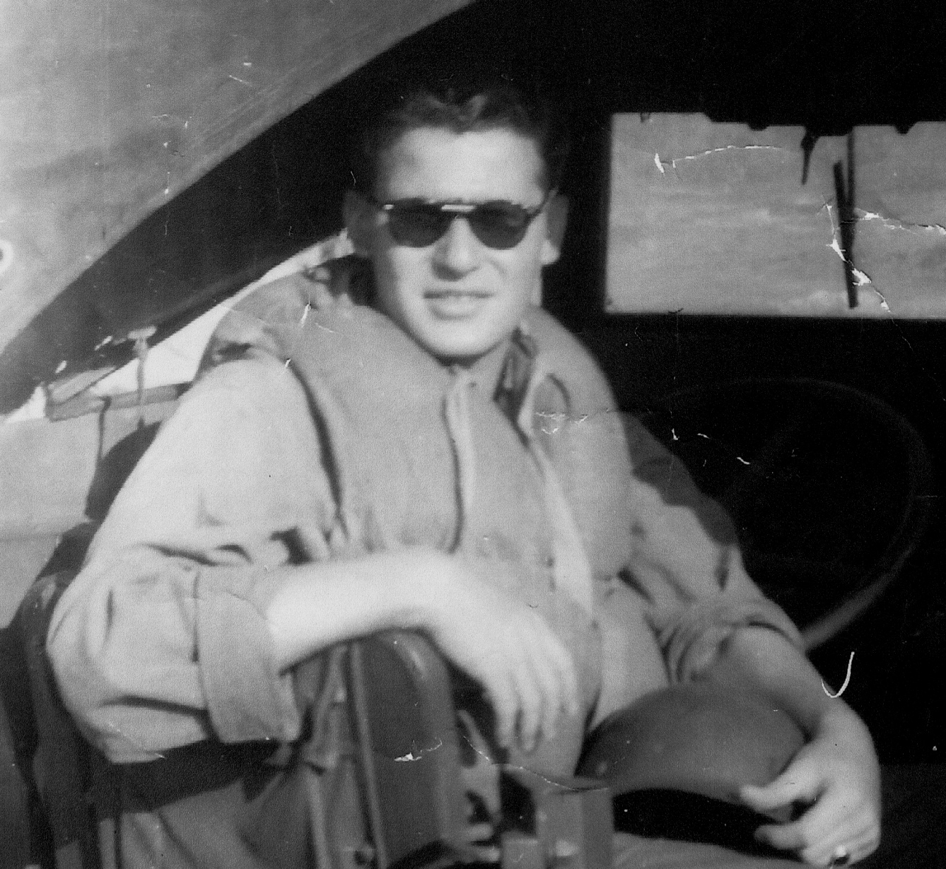
Lou LaRiche

Slide 32
Ted
Matley

Slide 33
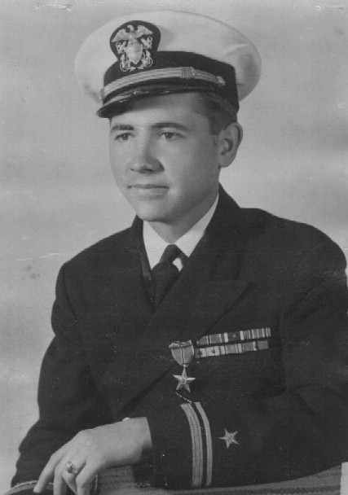
E. J.
McClendon

Slide 34
Charles “Eddie”
Olson

Slide 35
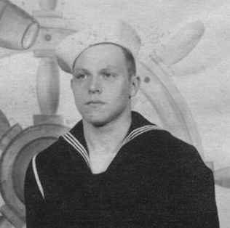
Ed
Quant

Slide 36
Charles “Gordy”
Shaw

Slide 37
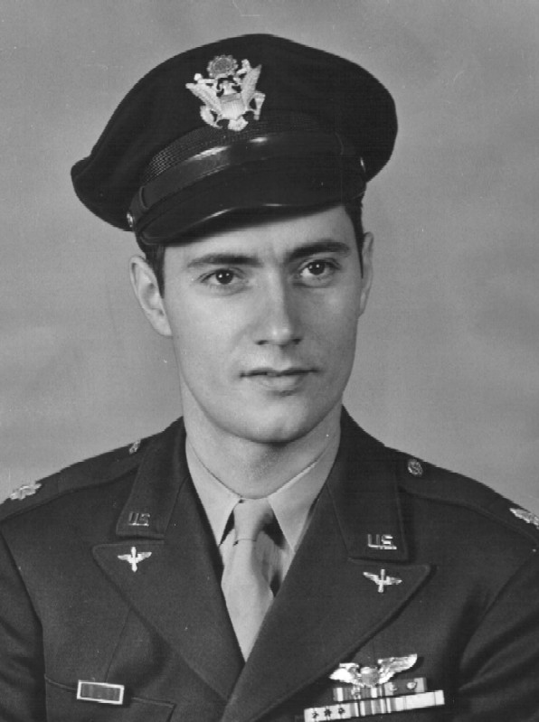
Al
Stanwood

Slide 38
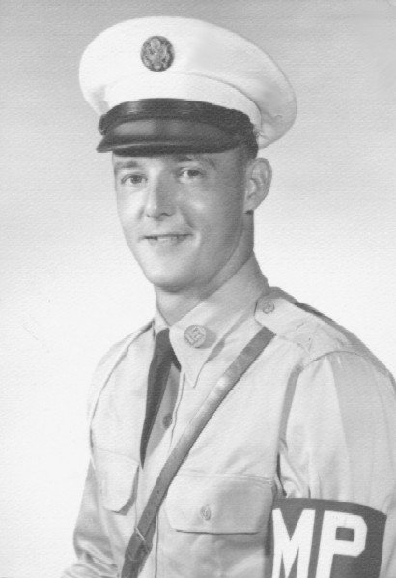
Pete
Stone

Slide 39
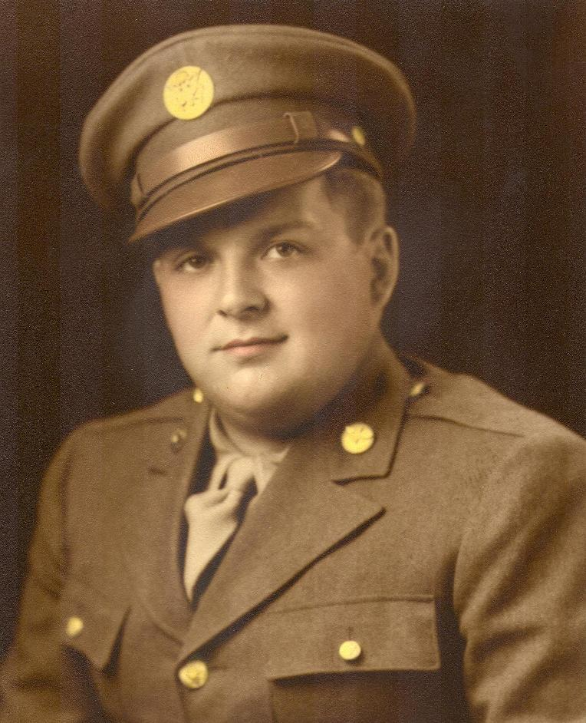
Bob
Stremich

Slide 40
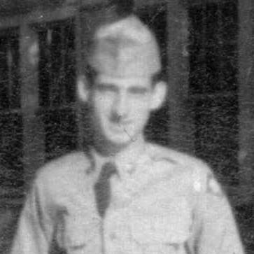
Joe
Tate

Slide 41
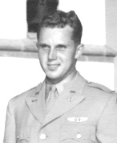
Jack Tornga

Slide 42
Larry
Turner

Slide 43
Earl
West

Slide 44
Dan
White

Slide 45
Harvey
Ziel

Slide 46


Slide 47
Plymouth
Rotary
Club

